Slide 1

FitMantra
THE VIRTUAL GYM
TRAINER
Enhance your fitness journey with smart assistant

Slide 2



The Problem
Unaffordability of Personal Trainers: High costs make trainers inaccessible to most.
Inconsistent Trainer Monitoring: Even with a trainer, full attention is rare, increasing the risk of injuries.
Lack of Motivation: Staying motivated is tough without consistent rewards or a supportive community
LEARN NOW

Slide 3
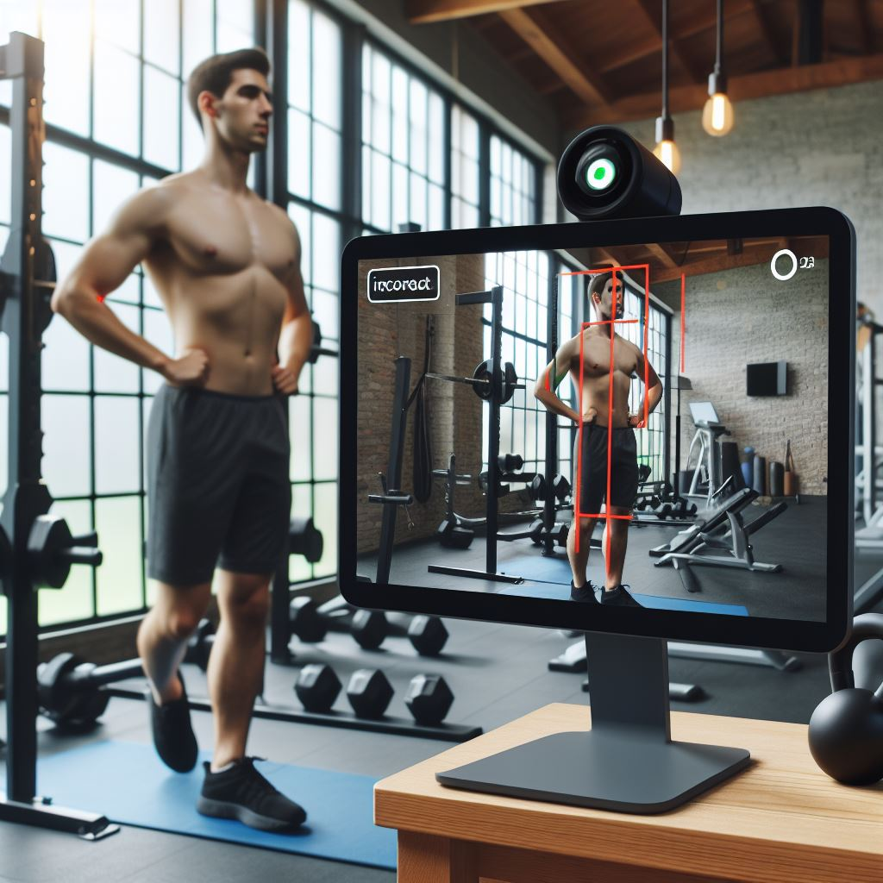
The Solution
AI-Driven Posture Monitoring: Cameras mounted on gym equipment track users' movements and provide real-time posture correction to ensure proper form and reduce injury risk.
Gamified Fitness Journey: Achieve milestones, earn points, and redeem them for brand vouchers, keeping users motivated and engaged.
Socialized Fitness Platform: Connect with other fitness enthusiasts, share progress, and celebrate achievements—India’s first gym-based social community.
LEARN NOW
FitMantra

Slide 4

The Innovation
AI-Powered Posture Correction: Real-time camera-based monitoring ensures users maintain proper form throughout workouts, reducing injury risks.
Gamified Fitness Engagement: Users earn points for completing milestones, which can be redeemed for vouchers, boosting motivation and consistency.
Social Fitness Network: India’s first community platform for gym enthusiasts, where users can share progress and get inspired by others.
LEARN NOW
FitMantra

Slide 5
Relevance & Impact
Affordable Guidance
Accessible to middle-class users.
Motivation Through Rewards
Gamification makes fitness engaging and rewarding.
LEARN NOW
Community and Support
Social platform fosters a sense of belonging.
Injury Prevention
Real-time posture correction reduces risks.
Increased Motivation and Retention
Rewards system keeps users engaged.
Stronger Fitness Community
Social ecosystem makes fitness fun and interactive.
FitMantra

Slide 6

Market & Opportunity
Exploring the vast potential of FitMantra
TAM
Global fitness industry exceeding $100 billion
SAM
Indian fitness industry projected to reach $6 billion by 2025
SOM
Targeting 5-7% market share in India

Slide 7

Research Data
Primary Research: Surveys conducted among gym-goers indicate that 60% of users find personal trainers too expensive, and 75% are interested in tech-based solutions to improve their workout experience.
Secondary Research: Reports from industry experts predict a 40% increase in demand for AI-powered fitness solutions by 2025, driven by technological advancements and the gamification of fitness.

Slide 8




Competitive Landscape
Traditional Solutions
Personal Trainers, Fitness Apps, Online Coaching.
Potential Competitors
Fitness Coaching Apps, Virtual Training Platforms, Wearable Tech.
FitMantra's Advantage
Real-time correction, gamification, community.
FitMantra

Slide 9

Competitive Advantage
FitMantra stands out with its unique features and value proposition
1
Real-Time Posture Correction
Immediate feedback for proper form
2
Gamified Fitness
Reward system for consistent engagement
3
Social Fitness Community
Connecting with fellow enthusiasts
4
Affordability
Lower cost compared to personal trainers

Slide 10
Lean Canvas
Problem
Lack of affordable personal gym trainers.
Low motivation to sustain fitness goals.
Difficulty in tracking and improving gym performance and posture without supervision.
Solution
Mounted cameras on gym equipment that detect user posture and provide corrective feedback in real time.
Gamified system where users earn points for achieving fitness milestones, redeemable for vouchers.
A personalized fitness plan with consistent tracking to motivate users.
Unique Value Proposition "India’s first socialized virtual gym trainer platform. FitMantra combines affordable fitness guidance with real-time posture correction and gamified motivation, all while fostering a gym community like LinkedIn for professionals."
Unfair Advantage
Integration of physical hardware (cameras) with virtual gym coaching.
Gamified rewards and socialized platform for the fitness community, exclusive to FitMantra.
Data-driven personalized fitness plans and continuous monitoring.
Existing Alternatives
Personal gym trainers (expensive).
Fitness apps offering workouts without real-time posture correction.
General social media for sharing fitness journeys without gym-specific context.
Key Metrics
Number of users subscribing to monthly/annual plans.
User engagement (time spent on the app, leaderboard participation).
Number of milestones achieved and points redeemed.
Posture corrections provided per session.
Early Adopters
Fitness enthusiasts in metro cities with gym memberships.
Young professionals looking for affordable fitness coaching.
Individuals motivated by gamified progress and rewards.
Channels
Mobile app (primary), website.
Social media marketing, influencer partnerships.
In-app chatbot for support and guidance.
Cost Structure
Camera hardware and installation on gym equipment.
App development and maintenance.
Marketing and customer acquisition costs.
Affiliate marketing and partnerships management.
Revenue Streams
Subscription models: ₹999/month, ₹4,999 for 6 months, ₹8,999/year.
Affiliate marketing from fitness products and supplements.
Brand partnerships for voucher rewards.
Customer Segments
Middle-class individuals seeking affordable fitness solutions.
Fitness enthusiasts looking for guidance and motivation.
Gym-goers who prefer social platforms to share progress and stay motivated.

Slide 11

Business Model
Subscription Model:
Monthly Subscription: Users can subscribe to FitMantra at ₹999/month or ₹4,999 for 6 months.
Annual Subscription: Option for ₹8,999/year for cost savings and commitment incentives.
Affiliate Marketing:
Revenue from promoting fitness products, supplements, and gear through affiliate links in the app.
Fitness Data Licensing:
LEARN NOW
Aggregate anonymized user data (exercise habits, popular routines, workout frequency) and sell it to fitness brands, sportswear companies, or health research firms.
FitMantra
Revenue Projection Schedule:
Year | Expected Revenue (in ₹) | Key Milestones
1 | 2 Crores | Launch and initial user acquisition
2 | 5 Crores | Expanded marketing and partnership deals
3 | 10 Crores | Established user base and brand presence
4 | 20 Crores | Expansion into new markets

Slide 12
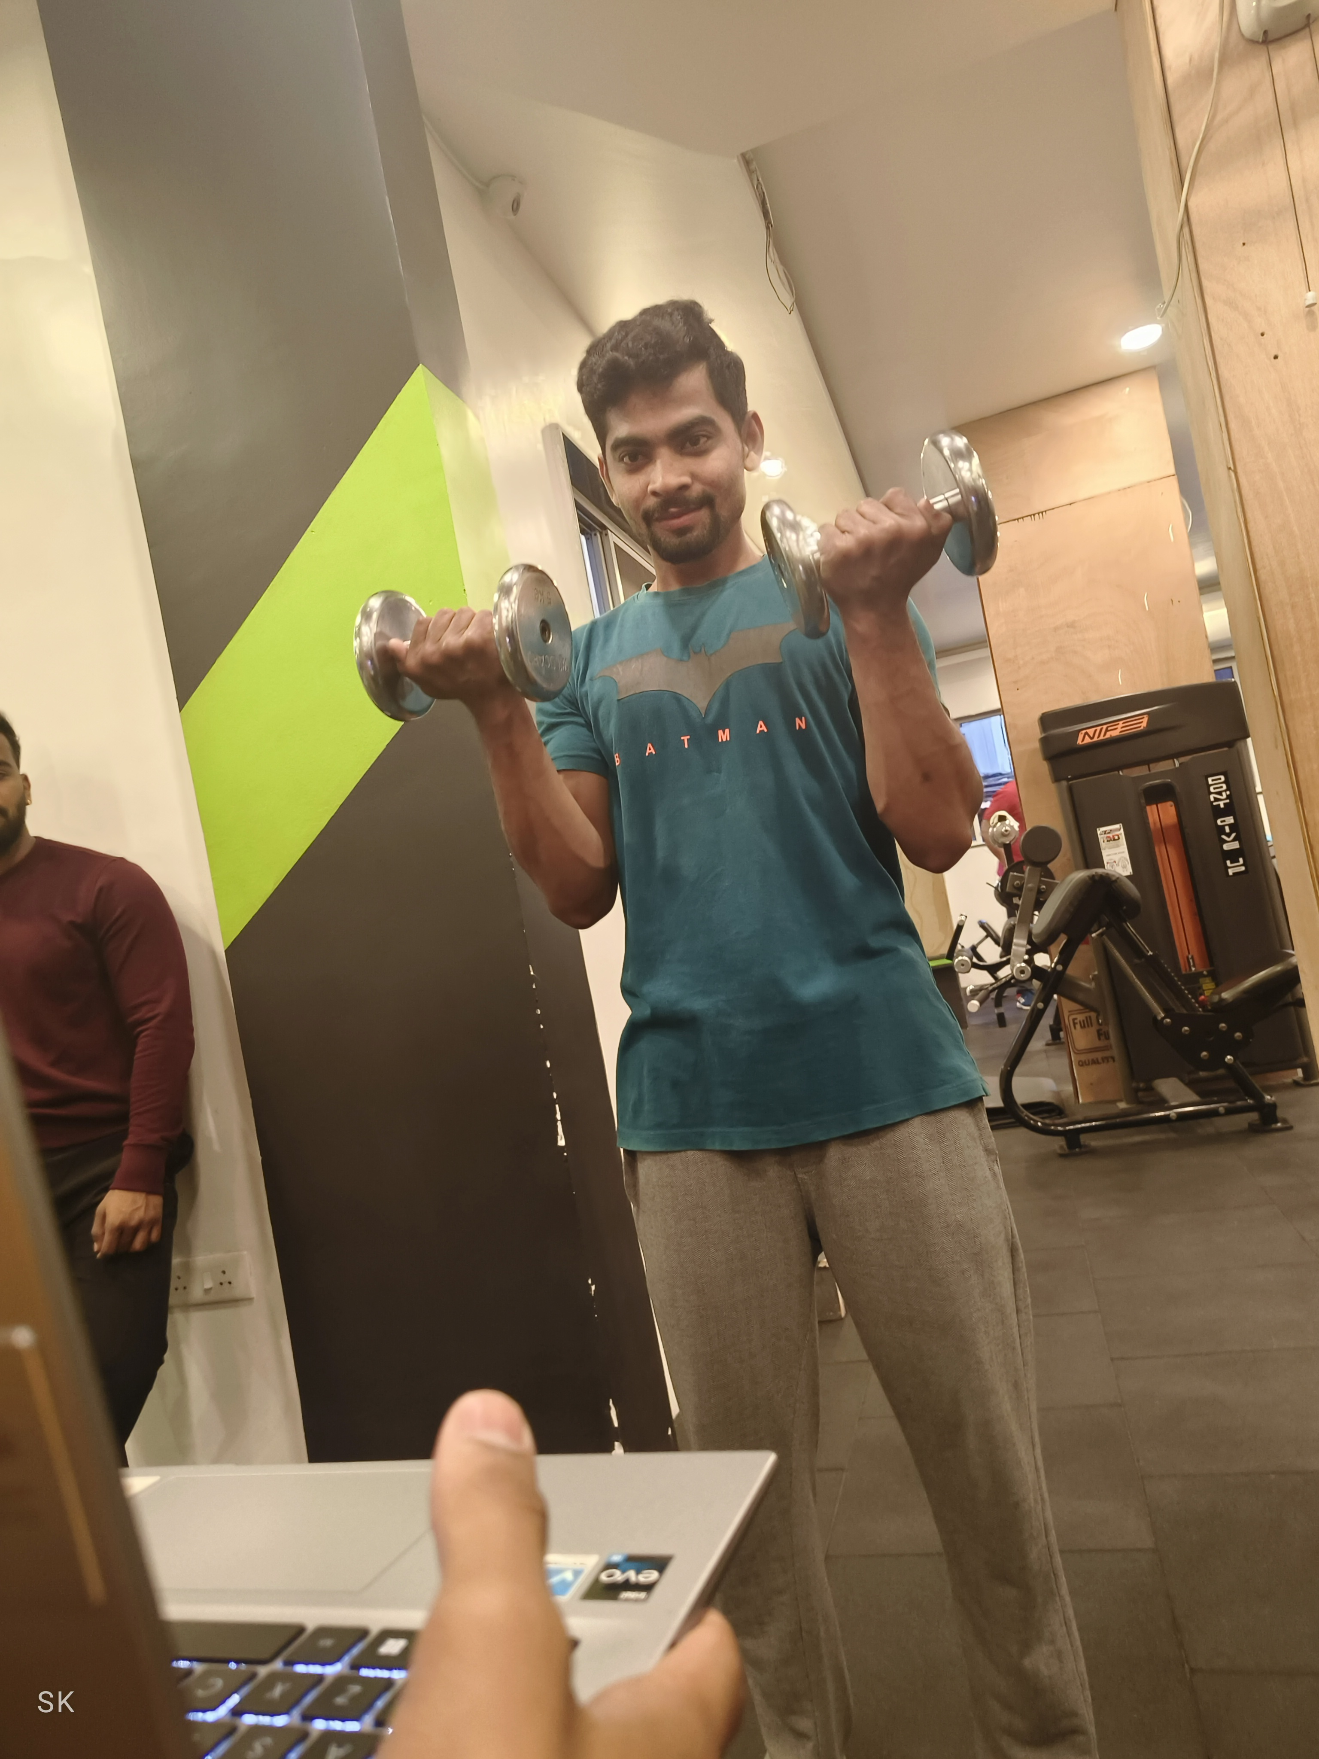
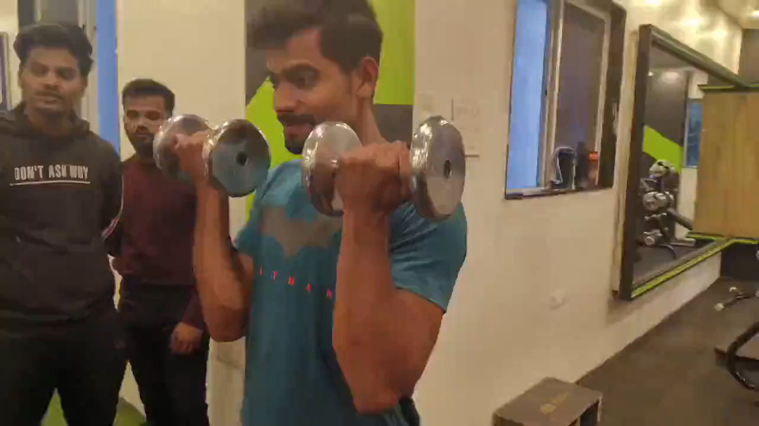
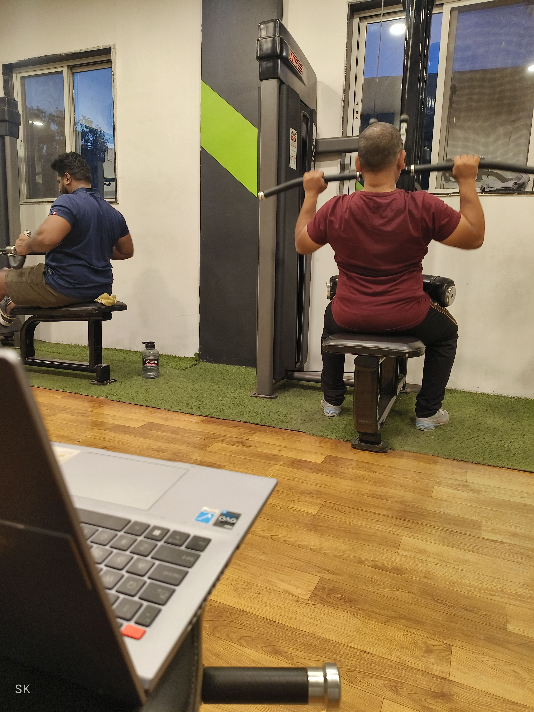
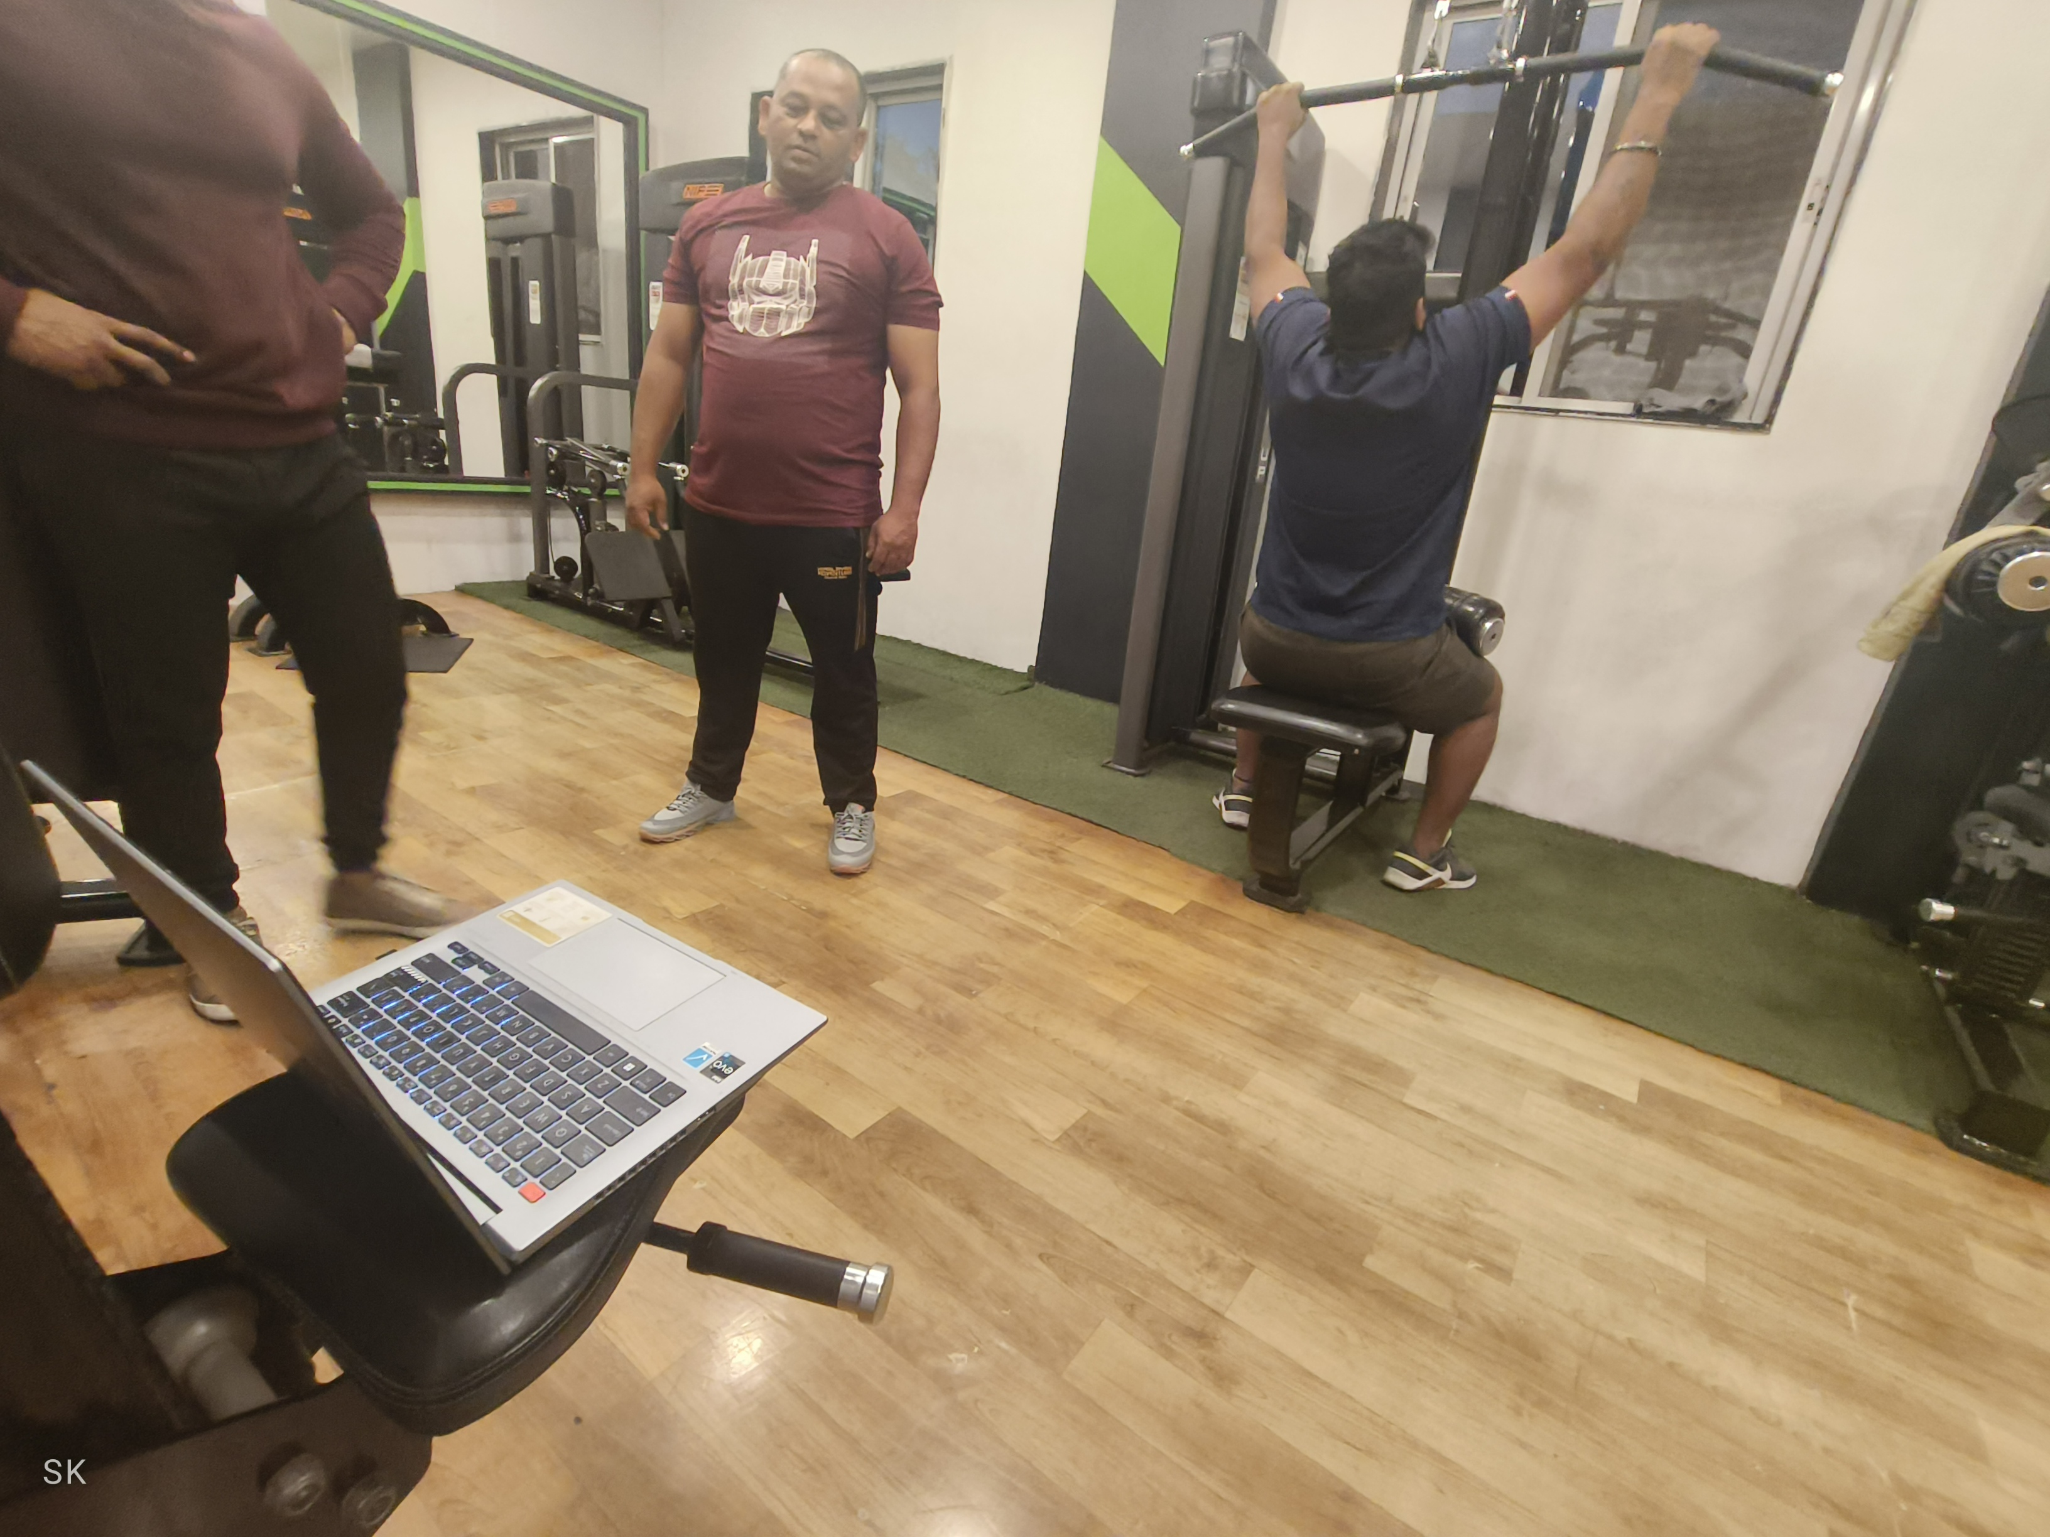
Market Adoption
Feedback
FitMantra

Slide 13

The Overview
About Me:
I am a 3rd year student of engineering(Artificial Intelligence and Data Science)
Winner of Multiple Hackathons:
International Hackathon in Europe
Various National Hackathons
Several State-Level Hackathons
Sumit Kolpe
Vision: To revolutionize the fitness industry by creating accessible and engaging solutions that motivate individuals to achieve their health goals.
LEARN NOW
FitMantra

Slide 14

Thank you...

